Slide 1

Employee Performance Analysis using Excel
Name: Anisha jain
Register No: 312215903
Department : B.com Accounting and finance
College: Shri Shankarlal Sundarbai Shasun Jain college

Slide 2



Project Title
Employee performance analysis using excel

Slide 3
Agenda
1
Problem Statement
2
Project Overview
3
End Users
4
Our Solution and its Value Proposition
5
Dataset Description
6
Modeling Approach
7
Results and Discussion
8
Conclusion

Slide 4

Problem Statement
Lack of Data-Driven Insights
Inefficient Performance Tracking
The organization currently relies on subjective and anecdotal assessments of employee performance, lacking a structured and objective framework for evaluation.
Existing performance tracking methods are often manual, time-consuming, and prone to errors, making it challenging to effectively monitor employee progress.
Limited Actionable Insights
The current system struggles to provide actionable insights that can be used to address performance gaps and develop targeted interventions.

Slide 5
Project Overview
Objective
Scope
Methodology
To develop a data-driven and comprehensive employee performance analysis system using Excel.
This project will analyze historical employee performance data, identify key performance indicators, and develop actionable insights for improving individual and organizational performance.
The project will utilize Excel's powerful data manipulation and visualization capabilities to analyze the employee performance data, identify trends, and generate meaningful insights.

Slide 6




End Users
HR Professionals
HR professionals will leverage the insights from this project to develop effective employee performance management programs, including training, development, and performance improvement initiatives.
Managers
Managers will utilize the data and insights generated to effectively evaluate employee performance, identify strengths and weaknesses, and provide targeted coaching and feedback.
Employees
Employees will benefit from the project by receiving clear feedback on their performance, identifying areas for improvement, and accessing opportunities for growth and development.

Slide 7





Our Solution and its Value Proposition
Excel-Based Performance Analysis
We propose a solution using Excel to analyze employee performance data, leveraging
its data manipulation, visualization, and analytical capabilities.
Data Collection and Organization
We will gather employee performance data from various sources, including performance reviews
Surveys, attendance records and project completion data, and organize it in a structured format.
Data Analysis and Visualization
We will utilize Excel's formulas, functions, and charts to analyze the data,
identify trends, and visualize key performance indicators, making it easier to understand and interpret the findings.
Based on the data analysis, we will generate actionable insights recommendations for improving employee performance, including targeted interventions, training programs, and performance improvement initiatives.
Actionable Insights and Recommendations

Slide 8
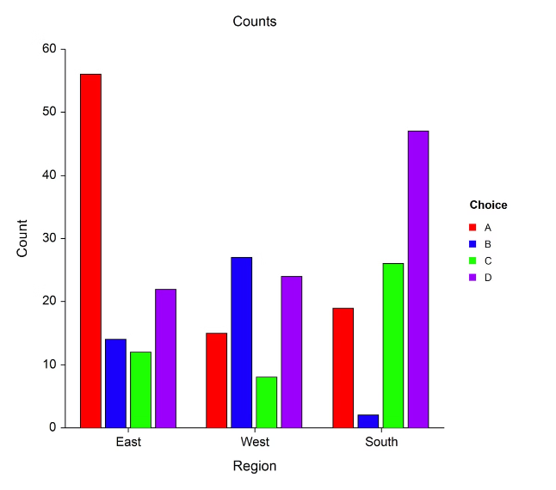
Dataset Description
Some attributes in dataset are :
Employee ID
Employee Name
Department
Job Title
Skills
Performance Rating

Slide 9

THE “WOW” IN OUR SOLUTION:
Customizable dashboards for tailored insights
AI-powered performance forecasting and predictions
Gamification and incentives for employee engagement
Scalable solution for growing businesses
Automated performance reporting and analysis
Real-time feedback and coaching tools
Seamless integration with existing HR systems

Slide 10
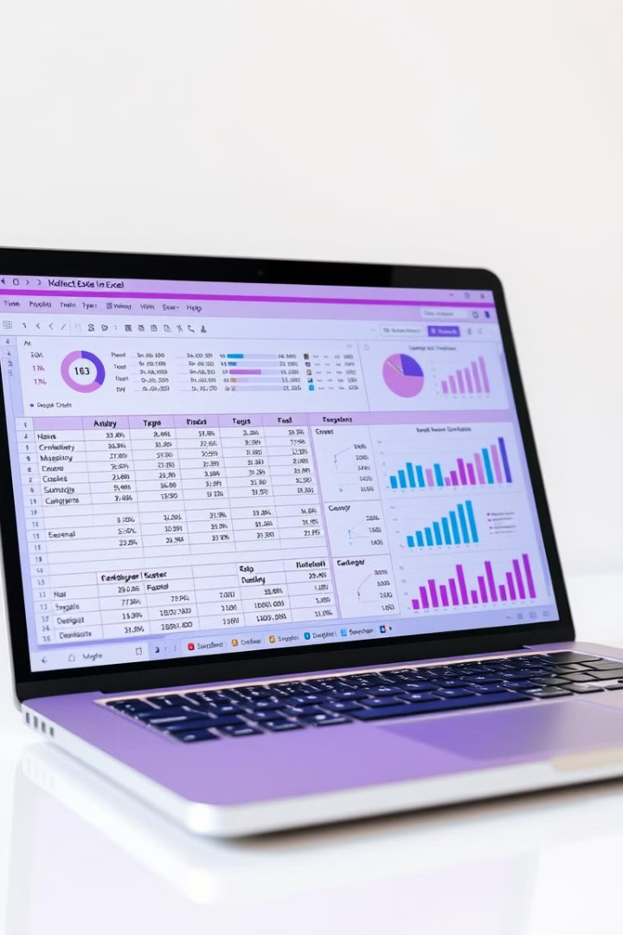
Modeling Approach
1
Descriptive Analysis
3
Regression Analysis
We will use Excel's descriptive statistics functions to calculate measures like mean, median, standard deviation, and percentiles to summarize the employee performance data and identify key trends.
We will utilize Excel's regression analysis tools to build predictive models that can identify factors that significantly influence employee performance and forecast future performance based on historical data.
2
Correlation Analysis
4
Data Visualization
We will analyze the correlations between different performance variables using Excel's correlation functions to understand how factors like skills, experience, and training impact overall performance.
We will use Excel's charting capabilities to create visualizations like bar charts, pie charts, scatter plots, and line charts to present the data insights in a clear and compelling manner.

Slide 11
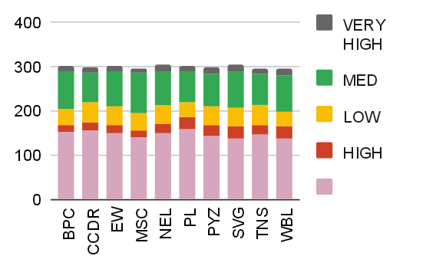
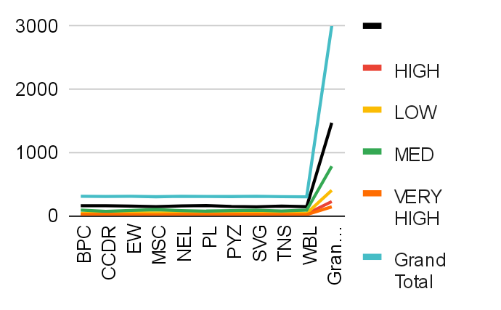
Results and Discussion

Slide 12
Conclusion.
The project 'Employee Data Performance using Excel' has been completed.
The project aimed to analyze and visualize employee data using Excel. The objectives of the project have been achieved, and the expected outcomes have been realized.
Excel has proven to be an indispensable tool in enhancing employee performance and productivity.
Excel enables employees to make informed decisions, identify areas for improvement, and track progress towards goals.

